Slide 1
SECURE DATA HIDING IN IMAGES USING STEGANOGRAPHY
SECURE THE DATA TO PREVENT HACKERS.
Presented By:
Student Name : Pavan Gedela
College Name & Department :Centurion University of Technology and Management (Computer Science ).

Slide 2
OUTLINE
Problem Statement
Technology used
Wow factor
End users
Result
Conclusion
Git-hub Link
Future scope

Slide 3
Problem Statement
Sensitive data is at risk of being intercepted by hackers and malicious actors.
This project aims to develop a secure data hiding mechanism in images using steganography to enhance data protection .
The focus is on improving embedding efficiency, maintaining image quality, and ensuring robust security against detection or extraction by unauthorized entities.
By implementing an optimized steganographic technique, the project seeks to provide a more secure and reliable method for covert data submission

Slide 4
Technology used
1.Python Programming Languages.
2.Steganographic Techniques like Least Significant Bit(LSB) method.
3.Cryptographic Techniques.
4.Libraries and frameworks like OpenCV .
5.Platforms like Stego.

Slide 5
Wow factors
1.Advanced Security Mechanisms.
2.High Data Hiding Capacity.
3.Improved Image Quaility and Imperceptibility.
4.Real time and cloud Integration

Slide 6
End users
1.Government and Defence Agencies.
2.Corporate Organizations .
3.Journalists and Whistleblowers.
4.Cybersecurity Professionals.
5.General Internet Uesrs.
I . Protect personal information
II . Securely store or share personal documents without raising suspicion.

Slide 7
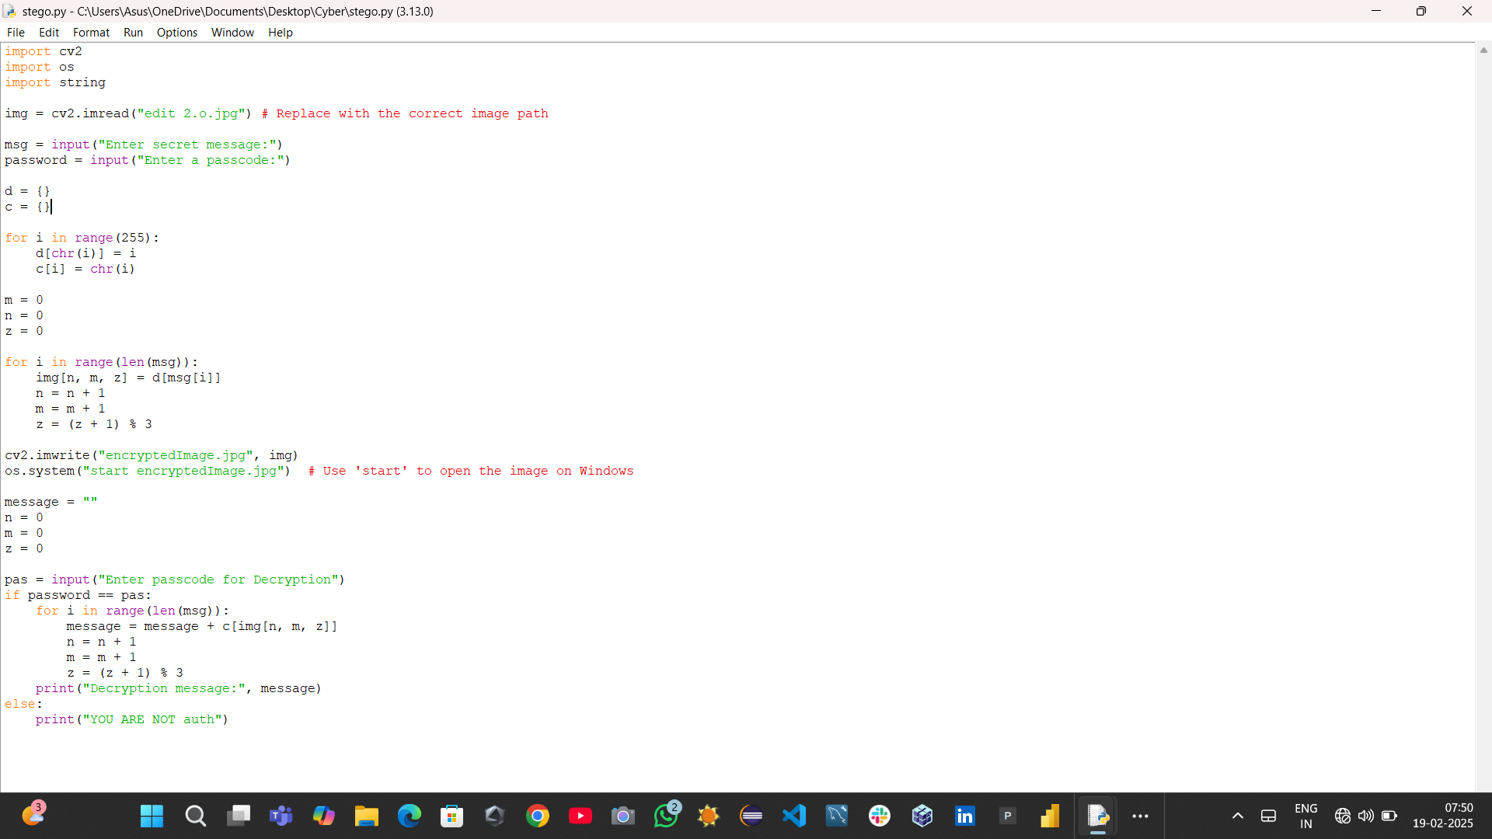
Results

Slide 8
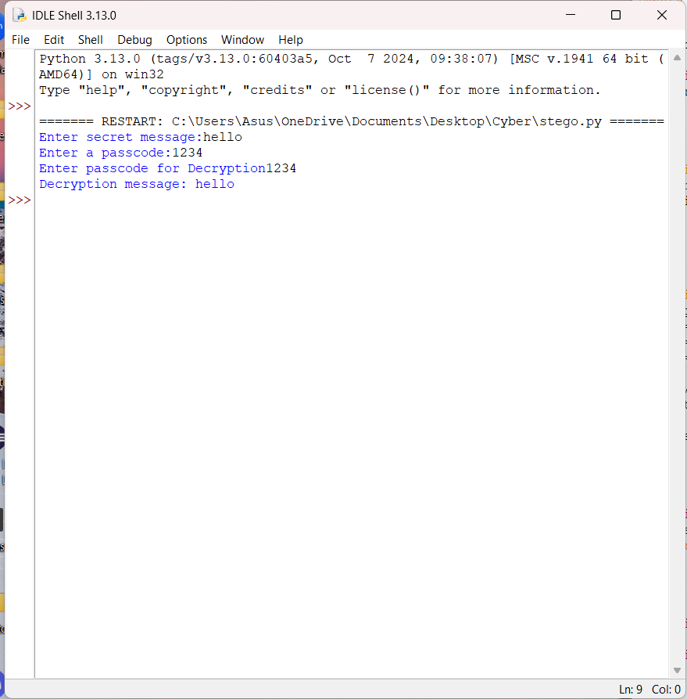
Results

Slide 9

Results

Slide 10
Conclusion
In an era where digital communication is highly vulnerable to cyber threats, traditional encryption methods alone may not be sufficient to ensure data security. Secure Data Hiding in Images Using Steganography provides a covert and effective solution by embedding sensitive information within images, making it nearly undetectable to unauthorized parties. By integrating advanced steganographic techniques with cryptographic security measures, this project enhances data protection while maintaining image quality and confidentiality. The proposed solution can benefit various sectors, including government, corporate organizations, cybersecurity, and personal privacy, ensuring safe and secure data transmission in an increasingly digital world.

Slide 11
GitHub Link
https://github.com/GedelaPavan/CYBER-SECURITY-STEGANOGRAPHY.git

Slide 12
Future scope(optional)
1.Enhanced Security with AI and Machine Learning
2.Hybrid Steganography and Cryptography
3.Real time Steganography Applications.
4.Cloud –based Steganography

Slide 13
THANK YOU

